Slide 1
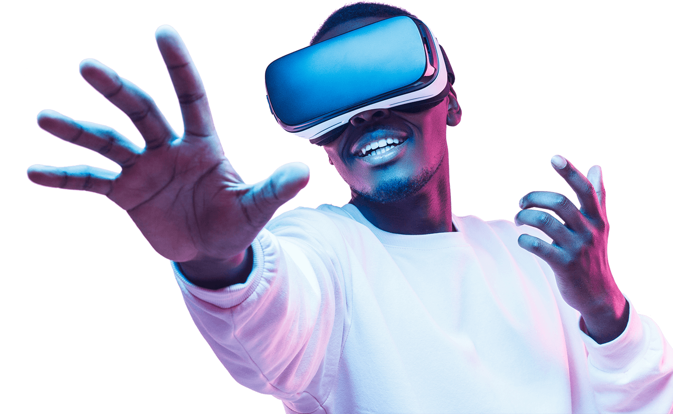
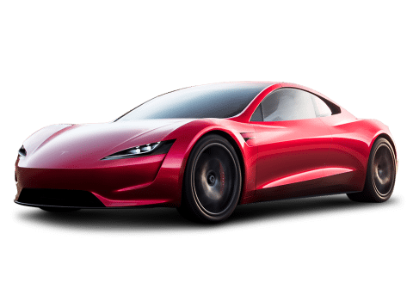
Driver Attentiveness in Virtual Reality
Professional Project (COM3001)
Student: James Wright
Supervisor: Dr. Steve Wesemeyer

Slide 2
Project Aim
The aim of the project is to investigate how different scenarios can positively or negatively effect a driver’s reaction time whilst driving a car.
Short-Term: Give information into which technologies (current or new) aid or distract drivers.
Long-Term: Help to push government regulations, inspire companies/entrepreneurs to create new technologies, ultimately - reduce road deaths.

Slide 3
Background knowledge

Slide 4
Literature Review: Road Accidents & Fatalities
On average, in Great Britain, 5 people die per day on the road and many more are injured. With the majority of the fatally injured being drivers & passengers [1].
Risk perception of the driver is a key factor in whether they will crash or not, independent of driver skill [6] – implying driving skill is not a significant factor, the overconfidence of a driver is.
Speeding and Distractions make up nearly 50% of the named causes for road fatalities [2].

Slide 5
Literature Review: Distractions
Operating a mounted Sat Nav whilst driving (programming route or following directions) is hypothesised to distract the driver, it is currently legal in the UK too [13] hence it would benefit from being studied to see if it has significant negative effects.
Handsfree phones and filming on a phone whilst driving are also legal in the UK [13] and are linked to driving accidents, so would be worth investigating.
Study [14] has shown that loud music in the car (above 95 decibels) can slow driver reaction times by 20%.

Slide 6
Literature Review: Driving Aids
Long-term fixes to this problem: Brain to Vehicle Technology [16], Automated Braking [17], Self-Driving Car Technology [18]; are all being researched and some are in cars to varying degrees – however these technologies could take decades to be perfected and commonplace.
Short-term aid would help to reduce deaths in the meantime.
Humans react to auditory stimulus a significant amount faster than visual stimulus [21], hence a good short-term solution that I could test would be to give an auditory alert whenever the car is in a dangerous situation. If the technology is successful then research could be done by others as to how to implement this feature in real life (Object recognition/detection algorithms, etc.)

Slide 7
Literature Review: Virtual Reality
Maximum of 30 minutes of Virtual Reality simulation per person recommended to minimise motion sickness [8] as well as regular breaks – a minute break per scenes should be fine (unless the user wants more time or wants to stop the test completely).
“a virtual emergency can be staged in a virtual environment since users would acknowledge it as such” [10] – this study adds credibility that the results from my experiment will be reliable, as they conclude that users treat virtual situations seriously. Hence, they will try and react correctly & as fast as possible in a “dangerous” situation (car accident in this context).

Slide 8
Literature Review: References Included in Presentation
[1] https://www.brake.org.uk/facts-resources/1653-uk-road-casualties - Brake UK 2017 report on road casualties.
[2] https://www.aceable.com/safe-driving/car-accident-statistics/ - Aceable US driving fatality data (2007 – 2012).
[6] https://www.sciencedirect.com/science/article/pii/S0001457513003497?via%3Dihub - Accident Analysis & Prevention (Volume 62, January 2014, Pages 63-78)
[8] https://www.businessinsider.com/virtual-reality-vr-side-effects-2018-3?r=US&IR=T#loss-of-spatial-awareness-1 – Business Insider “Here's what happens to your body when you've been in virtual reality for too long” by Kaylee Fagan (Mar 4, 2018, 4:00 PM)
[10] https://www.sciencedirect.com/science/article/pii/S0747563215000540?via%3Dihub - Computers in Human Behavior (Volume 48, July 2015, Pages 104-113)
[13] https://inews.co.uk/inews-lifestyle/cars/mobile-phone-driving-law-changes-explained-uk-new-legislation-824749#:~:targetText=At%20the%20moment,%20using%20a,nav%20while%20driving%20is%20illegal.&targetText=You're%20able%20to%20use,in%20these%20cases%20is%20illegal. – UK Mobile Phone Laws Whilst Driving
[14] https://www.idrivesafely.com/defensive-driving/trending/7-deadly-sins-distracted-driving-wrath-music - Music Whilst Driving Affecting Reaction Times (Newfoundland’s Memorial University study & Ben-Gurion University in Israel study)
[16] https://roadsafetygb.org.uk/news/brain-to-vehicle-technology-will-speed-up-reaction-times-nissan/ - Nissan Brain to Vehicle Technology (Article by RoadSafetyGB)
[17] https://mycardoeswhat.org/safety-features/automatic-braking/ - Automatic Braking explained (Article by MyCarDoesWhat.org)
[18] https://www.fool.com/investing/2017/10/22/how-far-along-is-self-driving-car-technology-reall.aspx - Self-Driving Cars Progress (Article by John Rosevear, Oct 22, 2017 at 7:05AM)
[21] https://www.sciencedirect.com/science/article/pii/000169188490043X - Visual and auditory choice reaction times (Acta Psychologica: Volume 55, Issue 3, May 1984, Pages 231-247)

Slide 9
Development Work

Slide 10
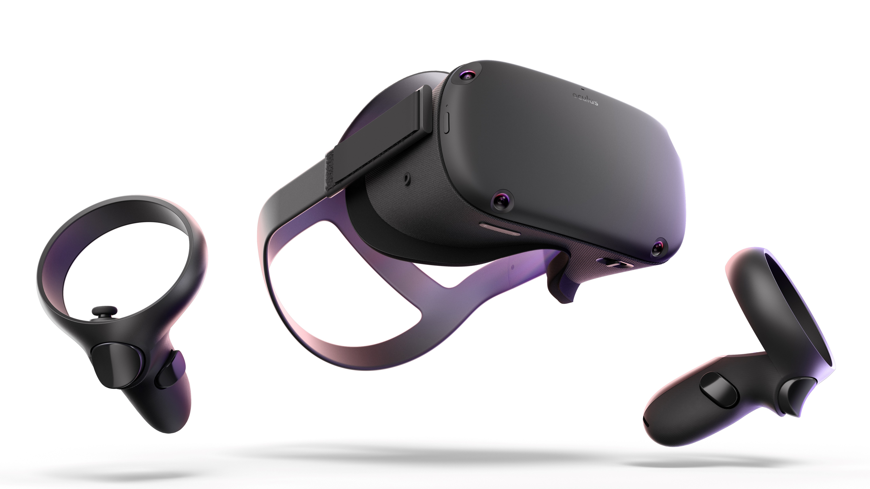


Receives user input & calculates result, outputs results to a local file (encrypted)
Exports application to the oculus device
User inputs button press in reaction to stimuli
Oculus Quest (VR)
Runs application
Screen records the user’s test
Transfers data from oculus (results & screen recordings) to the computer
User
Development Software
Gives written & verbal consent to do test and to use their data
Tells the user the instructions, and explains the test
Programs the application in unity
Fills out feedback form & gives to developer
Developer (Me)

Slide 11
Data Output from Testing
Data 1: User reaction time (float value) to the car emergency stopping.
Data 2: Boolean value (true/false) on if the user would have crashed into the car or not, based on stopping distance & the user reaction time.
Data 3: Boolean value (true/false) on if the user pressed the button before the trigger occurred (pre-emptive response) – essentially a fail statement in which case data 1 & 2 will be void.
Data 4: Screen recording of each test.
Data 5: Test feedback form (Questionnaire with 1 to 5 rating for each question).
Data 6: Demographic data from form (age, sex, race, work, relationship status, etc.) if the user gives consent to giving us their data.

Slide 12
Scenes: Calibration Scene
What:
Press the button as quickly as you can when a light in the virtual room turns green.
Why:
To get a control time for each of the user’s reaction time, something to compare the rest of the user’s results to. This also teaches the user the basic input needed for the actual test, as it will be the exact same controls and mechanisms.
How:
Occurs at the very start of the test, the user gets 3 attempts & the average is taken from the 3 attempts.

Slide 13

CALIBRATION SCENE
Basic version of this test developed and built.
UI (User Interface) and 3D models/environment to be improved in the future.
Displays average - calculated by [total/n] (where n is the total number of attempts).
*might change average to the median (middle number) to account for human error (not knowing how it works the first time, etc.)*

Slide 14
Scenes: Basic Class Diagram

Slide 15

Scenes: Scene 1
Scenario:
The car in front of the driver suddenly emergency stops.
Driving Variables:
Following Sat Nav instructions on a mounted display.
Loud music in car (over 95 decibels).
Loud auditory alert for when an emergency stop is needed.
*variables are randomised over the 3 scenes*

Slide 16
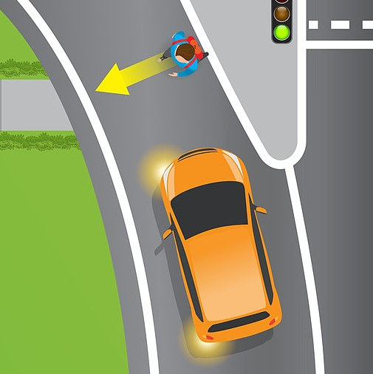
Scenes: Scene 2
Scenario:
Pedestrian crosses the road (not at a suitable crossing), directly in front of the car.
Driving Variables:
Following Sat Nav instructions on a mounted display.
Loud music in car (over 95 decibels).
Loud auditory alert for when an emergency stop is needed.
*variables are randomised over the 3 scenes*

Slide 17

Scenes: Scene 3
Scenario:
Traffic light turns red as the driver approaches it.
Driving Variables:
Following Sat Nav instructions on a mounted display.
Loud music in car (over 95 decibels).
Loud auditory alert for when an emergency stop is needed.
*variables are randomised over the 3 scenes*

Slide 18
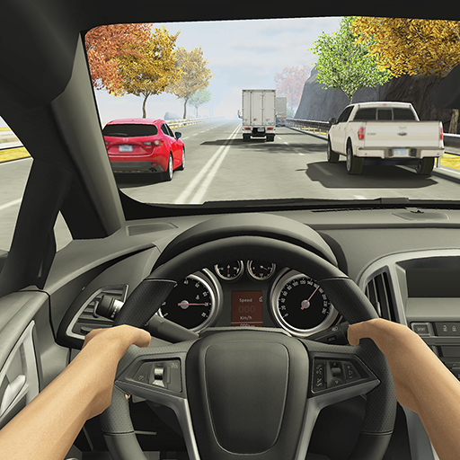
Example of the User’s View
First person view
Cockpit of car
Road environment
UK roads/cars unlike this image (E.g. left side of the road, wheel on right side of the car, etc.)
Image source: “Racing in Car 2” screenshot
https://play.google.com/store/apps/details?id=com.ffgames.racingincar2&hl=en

Slide 19


Software
GitHub: (Free Version)
For file management, version control, and backups.
Unity 3D: (Free Version)
For creating & scripting 3d environments & scenes – the main application.
Autodesk Maya: (Student Version - Free)
For creating realistic 3D models that can be textured, animated, & used as an asset within unity. It is industry standard.

Slide 20
Planning

Slide 21
Project Objectives
Become skilled and experienced using Unity in a 3D environment.
Learn how to program for Virtual Reality hardware.
Have a successful experiment, where at least 10 different people are tested & sufficient reliable data is collected.
Research different literature & data for both real and simulated experiments in similar areas.
Learn basic 3D modelling in Maya (as it’s industry standard).
Stick to a schedule and complete tasks on time.

Slide 22
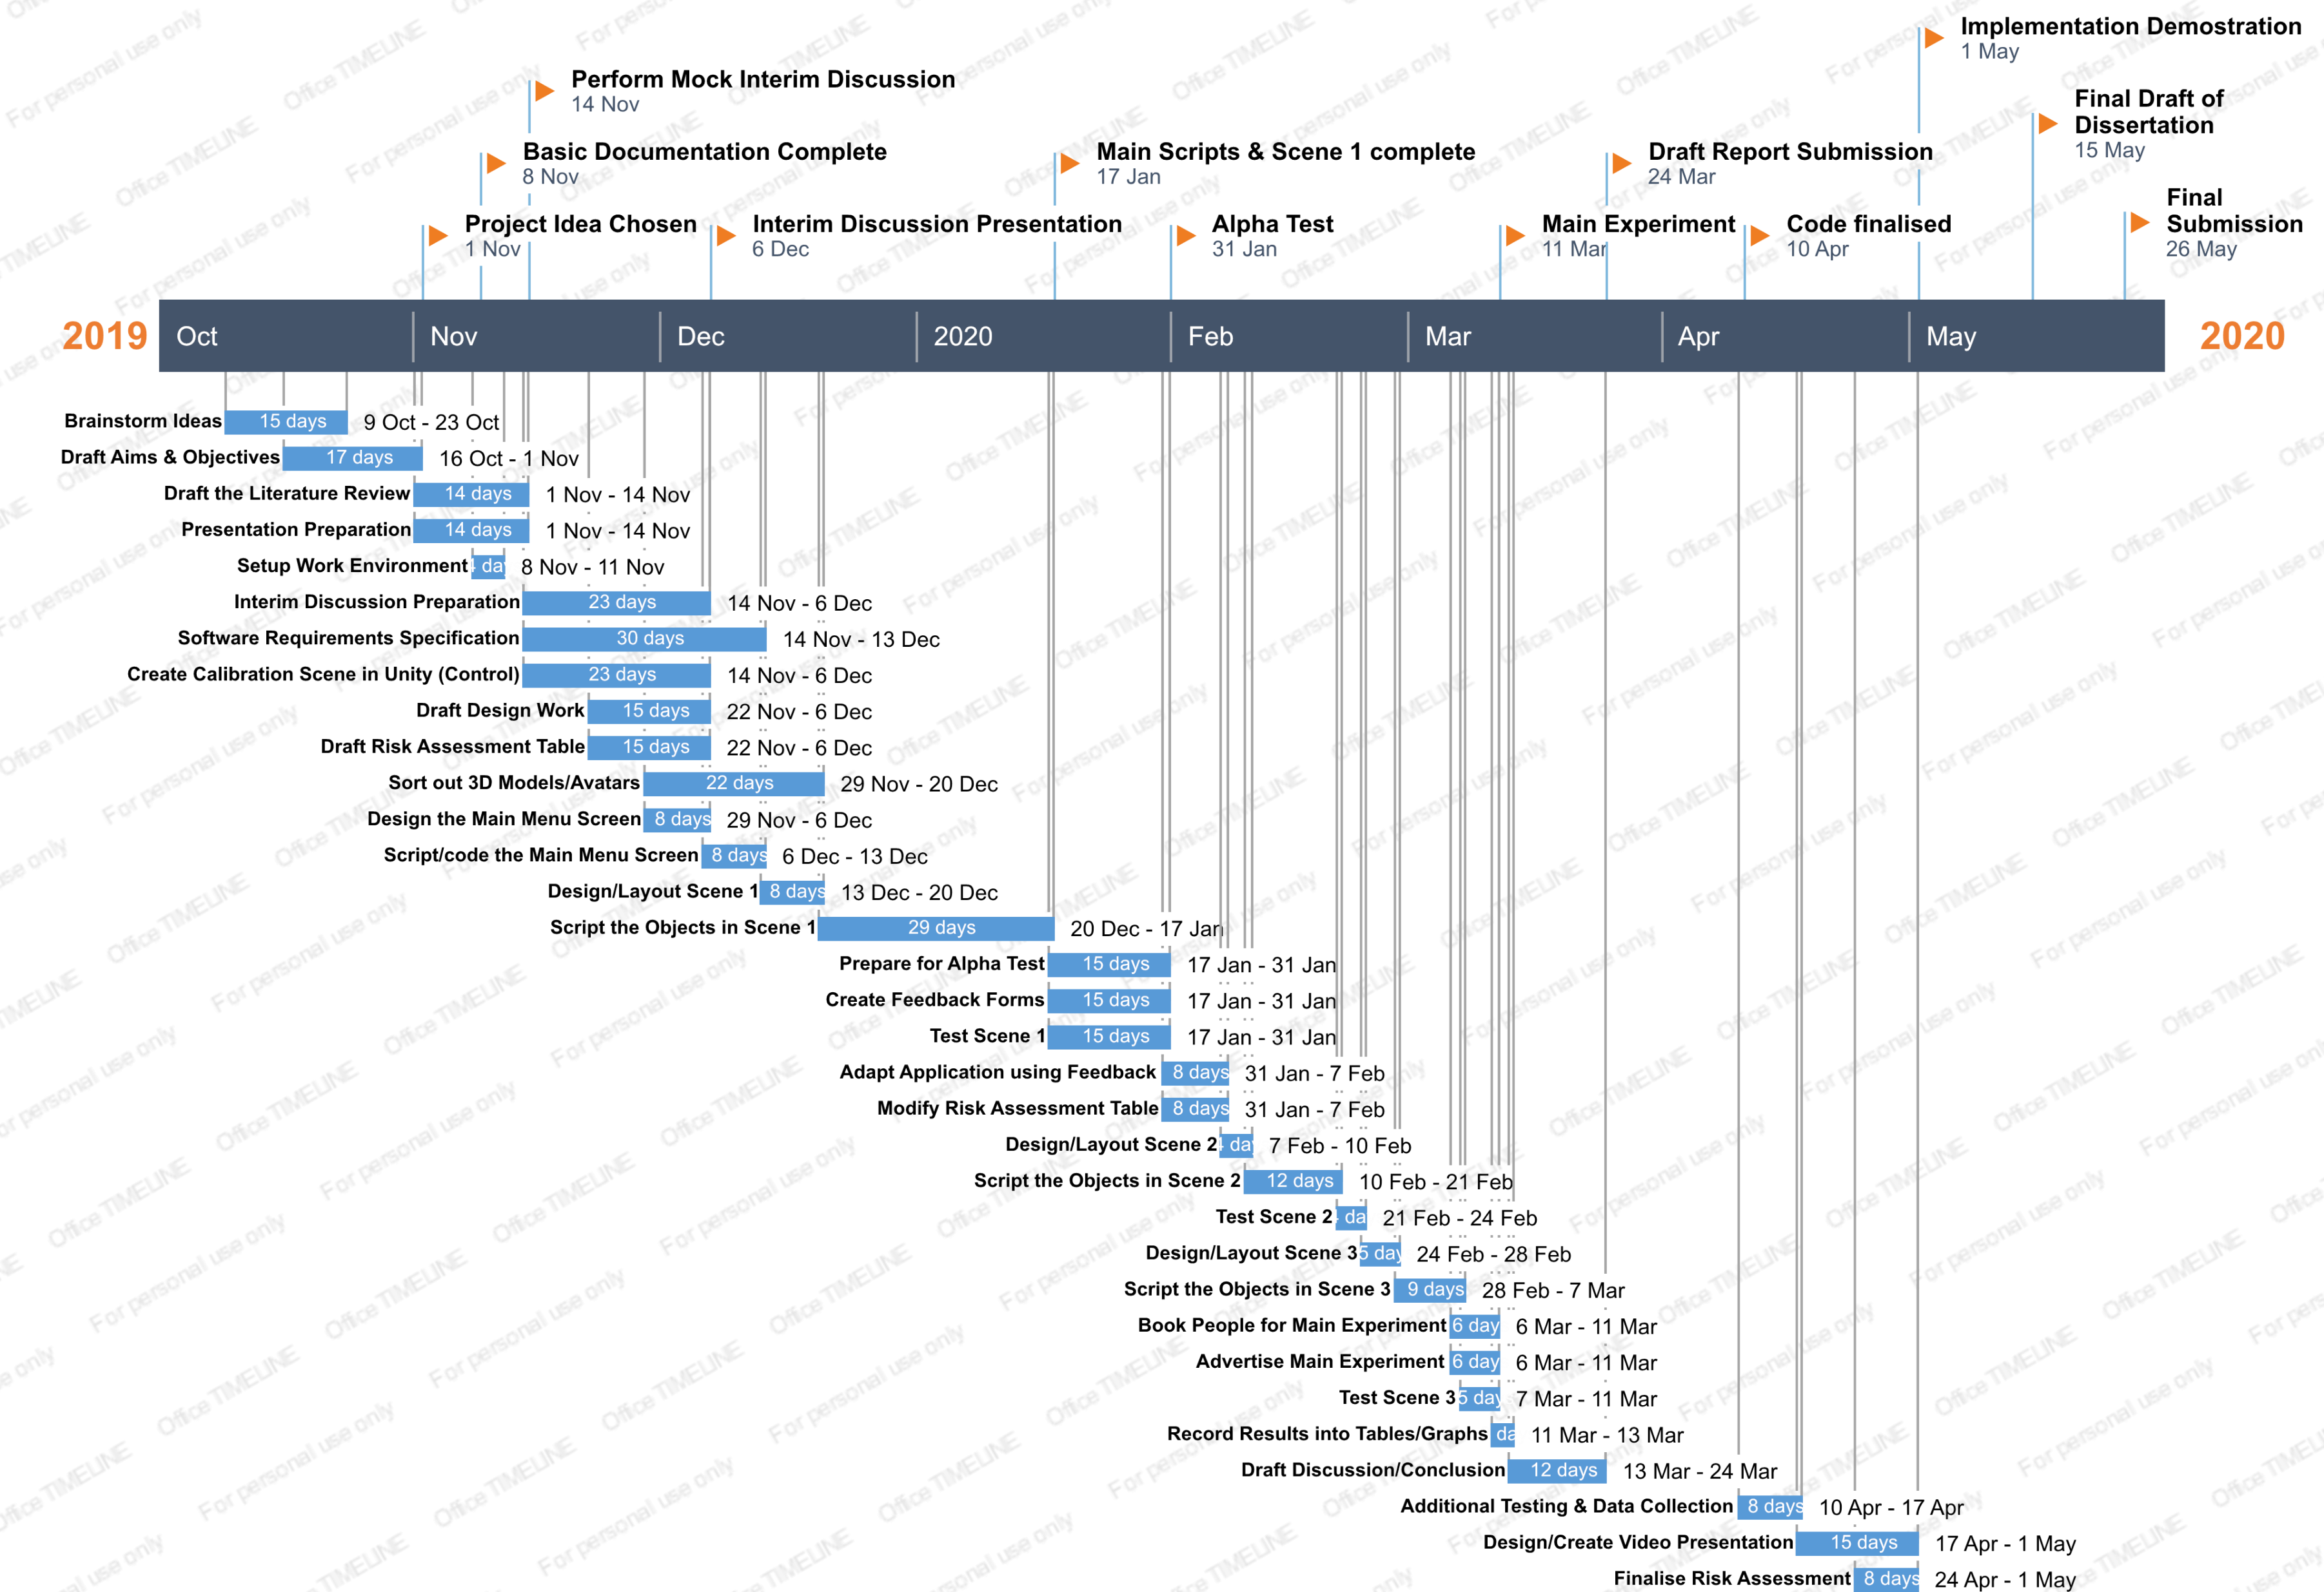
Tasks & Milestones

Slide 23
Progress So Far:
Setup Unity Project with GitHub (made sure only the appropriate files are committed too).
Drafts of Aims, Objectives, and Literature Review completed.
Milestones and timeline complete (plus to-do list for specific tasks).
Major design decisions done (Scenes, Driving variables, Inputs, Class Diagrams, Data Collection, etc.)
References for literature and for code (so far) recorded within documents.
Calibration (control) scene programmed, with only UI and visual improvements needed.

Slide 24

Thank you for listening! Any Questions?

